Slide 1

Pear Packer
We allow students to create questions on topics and from study materials automatically, so they:
Can test their knowledge
Have fun learning
Save a ton of time
We allow companies to find needed talent with maximum cost efficiency.

Slide 2
How do we make money?
Students go to the platform to make their learning easier
Students and teachers share created materials with others and play multiplayer games
=> Lots of students on the platform
Some students buy the premium => $
Companies see the traction and want to advertise their jobs on the platform => $$$

Slide 3
Team
We are all software specialists -> highly technical team
CEO – Ladislav Nagy – Built up a Youtube channel with over 10000 subscribers and over 16 years of watch time
CPTO – Jan Krátký – Built a platform for student project offers and companies liked it and gave him their offers
CTO – Egor Ulianov – 5 years of experience with contacts in European, Japanese and American enterprises
CMO – Lucia Domaníková – Ex-marketing school student with great contacts in student circles

Slide 4
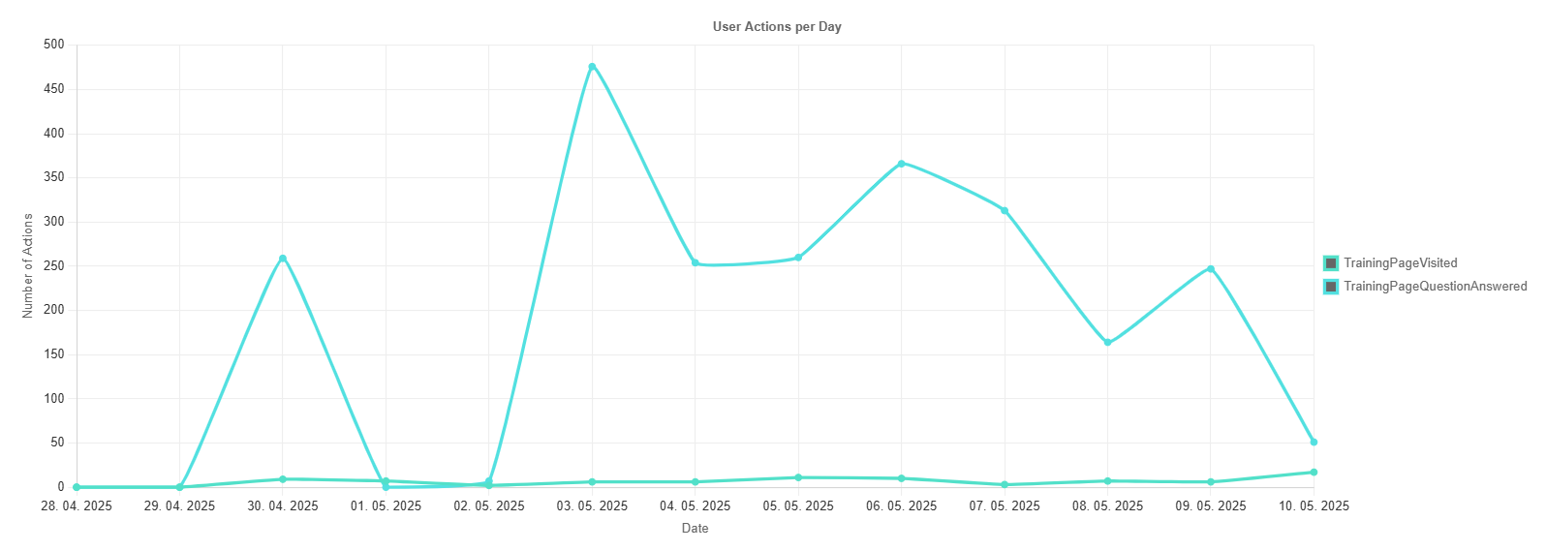
Traction
Average 300 answered questions per day last week

Slide 5
Market size
Student Learning Market (EdTech) | Company Recruitment Market (HR Tech)
🎓 Empowering Students | 💼 Connecting Companies with Talent
TAM: Global Digital Study Aids: $20B+ Annually | TAM: Global Student Recruitment: $50B+ Annually
(Based on ~250M global students & avg. spend) | (Based on online recruitment & grad hiring spend)
SAM (Czechia): | SAM (Czechia):
• ~300k University Students | • ~5,000 Companies Hiring Students/Grads
• Potential: $1.5M Annually | • Potential: $5M Annually
(Assuming 50k premium users @ $30/yr) | (Assuming avg. $1k spend/company/yr)
SOM (Czechia, Yr 3-5): | SOM (Czechia, Yr 3-5):
Projected: $150k - $300k Annually | Projected: $150k - $250k Annually
(Targeting 10-20% of addressable premium students) | (Targeting 3-5% of addressable company spend)

Slide 6
Try our demo!
https://smartgourd.github.io/PearPacker

Slide 7
What are we asking for?
We are seeking $150000
Via a Post-Money SAFE at $3M valuation and 20% discount

